Slide 1


YESHWANTRAO CHAVAN COLLEGE OF ENGINEERING
Department of Computer Technology
PQAI Seminar on
Advanced monitoring and control mechanism for electric vehicle charging station using Machine learning
PRESENTED BY: CT-23
Vedika Peshane - 31
Aditya Bhone - 39
Atharva Pophali - 47
Atharva Fukey - 48
Hariom Balang - 57
Kiran Wande - 103
SECTION : A
YEAR: 2024-25
COLLEGE GUIDE:
Prof.N.U.Sambhe
Co-guide from Electrical Dept.
Prof.P.S.Shete

Slide 2
Department Vision and Mission
Vision
To be a well-known center for pursuing computer education through innovative pedagogy, value-based education and industry collaboration.
Mission
To establish learning ambience for ushering in computer engineering professionals in core and multidisciplinary arena by developing problem-solving skills through emerging technologies.

Slide 3
Program Outcomes/Program Specific Outcomes
At the end of Program, Graduate students will have
PO1: Engineering Knowledge: Apply knowledge of mathematics, natural science, computing, engineering fundamentals and an engineering specialization as specified in WK1 to WK4 respectively to develop to the solution of complex engineering problems.
PO2: Problem Analysis: Identify, formulate, review research literature and analyze complex engineering problems reaching substantiated conclusions with consideration for sustainable development. (WK1 to WK4)
PO3: Design/Development of Solutions: Design creative solutions for complex engineering problems and design/develop systems/components/processes to meet identified needs with consideration for the public health and safety, whole-life cost, net zero carbon, culture, society and environment as required. (WK5)
PO4: Conduct Investigations of Complex Problems: Conduct investigations of complex engineering problems using research-based knowledge including design of experiments, modelling, analysis & interpretation of data to provide valid conclusions. (WK8).
PO5: Engineering Tool Usage: Create, select and apply appropriate techniques, resources and modern engineering & IT tools, including prediction and modelling recognizing their limitations to solve complex engineering problems. (WK2 and WK6)
PO6: The Engineer and The World: Analyze and evaluate societal and environmental aspects while solving complex engineering problems for its impact on sustainability with reference to economy, health, safety, legal framework, culture and environment. (WK1, WK5, and WK7).

Slide 4
Program Outcomes/Program Specific Outcomes
PO7: Ethics: Apply ethical principles and commit to professional ethics, human values, diversity and inclusion; adhere to national & international laws. (WK9).
PO8: Individual and Collaborative Team work: Function effectively as an individual, and as a member or leader in diverse/multi-disciplinary teams.
PO9: Communication: Communicate effectively and inclusively within the engineering community and
society at large, such as being able to comprehend and write effective reports and design documentation, make effective presentations considering cultural, language, and learning differences
PO10: Project Management and Finance: Apply knowledge and understanding of engineering
management principles and economic decision-making and apply these to one’s own work, as a member and leader in a team, and to manage projects and in multidisciplinary environments.
PO11: Life-Long Learning: Recognize the need for, and have the preparation and ability for i) independent and life-long learning ii) adaptability to new and emerging technologies
[PSO 1] An ability to acquire skills to design & develop quality software using cutting-edge technologies of Computer Engineering.
[PSO 2] An ability to use knowledge of various domains as per thrust areas to formulate and implement ideas for providing innovative solutions.

Slide 5
Course Outcomes
Course Outcomes | Program Outcomes |  |  |  |  |  |  |  |  |  |  | Program Specific Outcomes
 | 1 | 2 | 3 | 4 | 5 | 6 | 7 | 8 | 9 | 10 | 11 | PSO1 | PSO2
Identify a problem, analyze research gaps through a literature survey, and propose an ethical, innovative solution with societal impact. | 3 | 3 | 3 | 3 | 3 | 2 | 2 | 3 | 3 |  | 2 | 3 | 2
Develop a structured project report detailing the problem, methodology, proposed solution, and findings, adhering to professional and ethical standards. | 3 | 3 | 3 | 3 | 3 | 3 | 2 | 3 | 3 |  | 2 | 3 | 3
Implement a basic prototype/model to validate the proposed solution, demonstrating practical application of knowledge and technical skills. | 3 | 3 |  |  | 3 |  |  | 3 | 3 | 3 | 3 | 3 | 3
Avg | 3 | 3 | 3 | 3 | 3 | 2.5 | 2 | 3 | 3 | 3 | 2.3 | 3 | 2.6667

Slide 6
Contents
Introduction (Including Abstract, Aims and Objectives)
Literature Review/Patent search / PIR (project Investigation Report)
3.
Work Done
Conclusion
Patentability of the Project / Copyright
Social Utility
7.
References

Slide 7
Introduction
As electric vehicles (EVs) become an integral part of our daily lives, the need for smarter and more efficient charging infrastructure has never been greater. Charging stations must do more than just provide power — they need to be reliable, adaptable, and capable of meeting growing demand while minimizing energy waste.
Our project tackles this challenge by creating a predictive model using a data-driven approach and supervised machine learning. By analyzing both historical and real-time data, the model can forecast charging demand at charging stations, allowing energy to be distributed efficiently, reducing grid stress, and enhancing the user experience.
But it doesn’t stop there. The project also integrates advanced monitoring and control mechanisms, enabling real-time fault detection and better energy management. These features ensure charging stations remain efficient, safe, and capable of adapting to fluctuating energy loads and user needs.

Slide 8
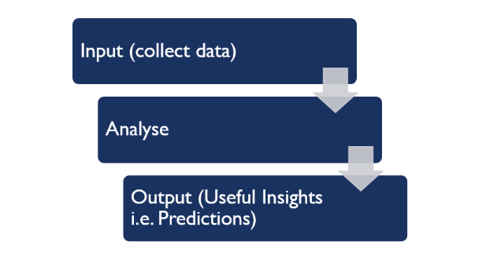
Aim
Our goal is to make EV charging smarter, safer, and more efficient using machine learning. This system will analyze real-time data to predict the best charging current, ensuring faster charging while protecting battery health. It will also have a built-in fault detection system that can fix common issues automatically and alert technicians if needed. By optimizing energy use and reducing downtime, this project aims to improve the overall EV charging experience and contribute to a more sustainable future.

Slide 9
Objective
Primary Objective/Problem Definition:
To design and develop a data-driven predictive model using supervised machine learning regression methods to accurately forecast charging demand at public charging stations, and to propose advanced monitoring and control mechanisms to optimize energy management, reduce peak demand, and enhance the overall charging experience.
Specific Objectives:
1.Develop model for Predictive analysis:Develop a machine learning-based predictive model that utilizes collected data to forecast charging demand and energy consumption.
2.To monitor and Predict: Design a real-time monitoring system that utilizes predictive analytics to forecast charging demand, detect anomalies, and optimize charging station operations.
3.To detect and manage fault: Develop a fault detection and management system that uses automated control mechanism to identify potential faults, alert operators, and provide recommendations for maintenance and repair.

Slide 10
Literature Review/Patent search / PIR (project Investigation Report)
Ref no, Year of publication | Title | Methodology Used | Dataset Used/Existing real time application | Performance parameters used | Performance Analysis | Limitations /Gaps
[1],2020 | Data-Driven Charging Demand Prediction at Public Charging Stations Using Supervised Machine Learning Regression Methods | Gradient Boosting (XGBoost), random Forest (RF), Support Vector Machine (SVM) | The research utilized seven years of charging data from Nebraska to explore applications in scheduling, grid stability, and smart grids. | Coefficient of Determination Root Mean Square Error (RMSE), Mean Absolute Error (MAE) | XGBoost achieved an RMSE of 6.68 kWh and an R-squared of 51.9%. | Limited dataset, potential difficulties in real-world application, and unforeseen challenges.
[2],2024 | Automatic Fault Detection And Analysis Of Electric Vehicle Charging Station By Machine learning | SVM, tree-based models, neural networks, semi-supervised learning, XGBoost. | Real-world EV data (charging rate, temperature, SOC, mileage), load resistance, simulated fault datasets. | Fault detection accuracy, training/execution time, algorithm generalizability, statistical error distribution, precision, recall. | XGBoost achieved 90.34% accuracy; proposed ML algo. reached 94.59% accuracy; | Inefficient traditional methods, limited real-world datasets, lack of scalability, need for higher accuracy/ speed.

Slide 11
Ref no, Year of publication | Title | Methodology Used | Dataset Used/Existing real time application | Performance parameters used | Performance Analysis | Limitations /Gaps
[3],2024 | Data-driven Short-term Electric Vehicle Charging Station Demand Forecasting | Random Forest,Support Vector Machine,Reinforcement Learning | -Battery Performance Data, Charging and Discharging Cycles Data. -Charging Stations, Battery Management Systems. | Mean Absolute Error,Root Mean Square Error, Coefficient of Determination (R²),Mean Absolute Percentage Error | High prediction accuracy achieved but requires optimization for real-time deployment. | Data scarcity, integration challenges, and limited adaptability to dynamic conditions.
[4],2023 | Machine Learning-based Electric Vehicle User Behavior Prediction | supervised learning techniques, feature engineering, data cleaning, and preprocessing. | Public charging dataset from Caltech Adaptive Charging Network (ACN), weather data from local station, and U.S. federal holidays calendar (2019) | Mean Absolute Error (MAE), Symmetric Mean Absolute Percentage Error (SMAPE), Root Mean Squared Error (RMSE), R² score | Achieved MAE of 1.45 kWh (energy consumption) and 66.5 minutes (session duration); improved prediction errors | Highly stochastic nature of public charging behavior compared to residential; dataset limited to a single location and year.

Slide 12
Ref no, Year of publication | Title | Methodology Used | Dataset Used/Existing real time application | Performance parameters used | Performance Analysis | Limitations /Gaps
[5],2023 | Quality of Service Evaluation and Forecast for EV Charging Based on Real-World Data. | M/G/K queue model, SARIMAX forecasting, simulation framework. | 6M records from Hydro-Quebec (2018-2022). | Charging Requests, Site Utilization, Occupancy, Blocking Probability, Waiting EVs, Avg. Waiting Time, QoS Evaluation. | QoS evaluation, demand forecasting, simulation of charging behavior. | Data gaps, regional generalization, COVID data gaps, limited exogenous factors, scalability issues.
[6],2023 | Optimizing Electric Vehicle Charging Station Placement in Urban Areas: A Data-Driven Approach. | Data Analysis, ML( k-means clustering,),Optimization Algorithm. | Real-world driving and charging data from metropolitan urban areas. | Peak-to-Average Ratio (PAR) Charging Waiting Time Operating Cost. | Reduced waiting time (67.6 to 22.8 min), power consumption (PAR 3.17 to 1.23), and costs (electricity 17.4%, maintenance 31.8%) | Limited dataset and user behavior variability Missing real-time traffic/weather data, generalization issues.

Slide 13
Ref no, Year of publication | Title | Methodology Used | Dataset Used/Existing real time application | Performance parameters used | Performance Analysis | Limitations /Gaps
[7],2023 | Enhancement of Charging Efficiency of Batteries for Electric Vehicles: Review. | Support Vector Machines,Fuzzy Logic Systems,Artificial Neural Networks (ANN). | Datasets: Battery performance, charge cycles. Applications: EV stations, BMS. | Charging efficiency, state of charge (SOC) prediction accuracy, battery health monitoring effectiveness. | Machine learning improves SOC prediction accuracy, advanced BMS enhances battery monitoring and protection. | High Computational Demands,Data Availability,affordable charging challenges.
[8],2023 | Design and Development of Smart Charging Infrastructure for Electric Vehicles. | Cloud-based intelligent models, , Linear and Binary Search for station filtering, priority scheduling for slot allocation.. | Combined dataset of 24,740 US EV stations and 3,395 charging sessions from Harvard Dataverse. | Accuracy , classification metrics (confusion matrix), price and distance prediction accuracy, scheduling efficiency. | Gradient Boosting showed high accuracy,, effective station filtering with search algorithms. | Limited real-time dynamic factors, less personalized user preferences, V2G functionality not implemented.

Slide 14
Ref no, Year of publication | Title | Methodology Used | Dataset Used/Existing real time application | Performance parameters used | Performance Analysis | Limitations /Gaps
[9],2022 | Electric Vehicle Charging Behavior Prediction using Machine Learning Models | K-means clustering,Machine Learning models (Random Forest, XGBoost). | Adaptive Charging Network (ACN) dataset with over 30,000 charging sessions from Pasadena, California. | Silhouette Index for clustering; Mean Absolute Percentage Error (MAPE) for prediction | K-means clustering (0.7726–0.7879). XGBoost achieved a MAPE of 0.146%, outperforming Random Forest (0.151%) | Limited to charging sessions from a specific location; cannot generalize findings globally, exploration needed for scalability and variations in real-world conditions.
[10],2022 | Machine Learning for Solving Charging Infrastructure Planning: A Comprehensive Review | Reinforcement Learning (RL), Linear Regression Mode, Support Vector Machine,Deep Learning | Real-world applications in Helsinki and Dundee for hotspot detection and grid planning. | Accuracy, error rates, costs, battery capacity, and efficiency | Supervised for accuracy; reinforcement for management | Data scarcity, integration issues, limited adaptability, and V2G gaps.

Slide 15
Ref no, Year of publication | Title | Methodology Used | Dataset Used/Existing real time application | Performance parameters used | Performance Analysis | Limitations /Gaps
[11],2023 | Data-Driven Analysis of EV Energy Prediction and Planning of EV Charging Infrastructure. | SARIMAX, Meta Fusion Regression, K-Means Clustering Algorithm. | California EV Charging Station Dataset Palo Alto Charging Station Dataset. | Mean Absolute Error (MAE), Root Mean Square Error, Coefficient of Determination. | SARIMAX: R² = 0.97, MAE = 6.50, RMSE = 17.43 Meta Fusion Regression: R² = 0.98, MAE = 0.91, RMSE = 2.26 | Limited dataset and user behavior variability, missing real-time traffic/weather data, generalization issues, and need for more resources.
[12],2021 | Analysis of Energy Consumption at slow Charging Infrastructure for Electric Vehicle. | Statistical analysis, transformed beta distribution, machine learning. | Geospatial datasets, historical electricity data, EV infrastructure planning. | Energy consumption distribution, location features, charging events, statistical significance. | High income/expensive housing increases usage, social assistance areas decrease it, XGBoost performs well. | Limited inclusion of location- specific features, insufficient focus on dynamic spatial and temporal aspects, reliance on deterministic models.

Slide 16
Ref no, Year of publication | Title | Methodology Used | Dataset Used/Existing real time application | Performance parameters used | Performance Analysis | Limitations /Gaps
[13],2020 | Machine Learning Approaches for EV Charging Behavior: A Review. | Decision trees,SVMs,neural networks, clustering, and regression models. | EV charging station logs,user behaviour patterns and simulation data. | Accuracy, precision, recall, and latency. | Decision trees,SVMs, and neural networks can effectively predict and optimize charging behaviour. | Limited diversity in datasets, lacks of real-world implementation and scalability testing in varied geographic regions.
[14],2021 | Analysis of Energy Consumption at Public Charging station. | Data-centric analysis, statistical methods. | Geospatial and socioeconomic datasets; charging events. | Energy modeled by transformed beta distribution; key factors include transactions, income, housing proximity, and social assistance. | Higher consumption linked to prosperous areas and businesses; lower in areas with high social assistance. | Time-intensive data collection; needs refined prediction models for deployment and grid planning.

Slide 17
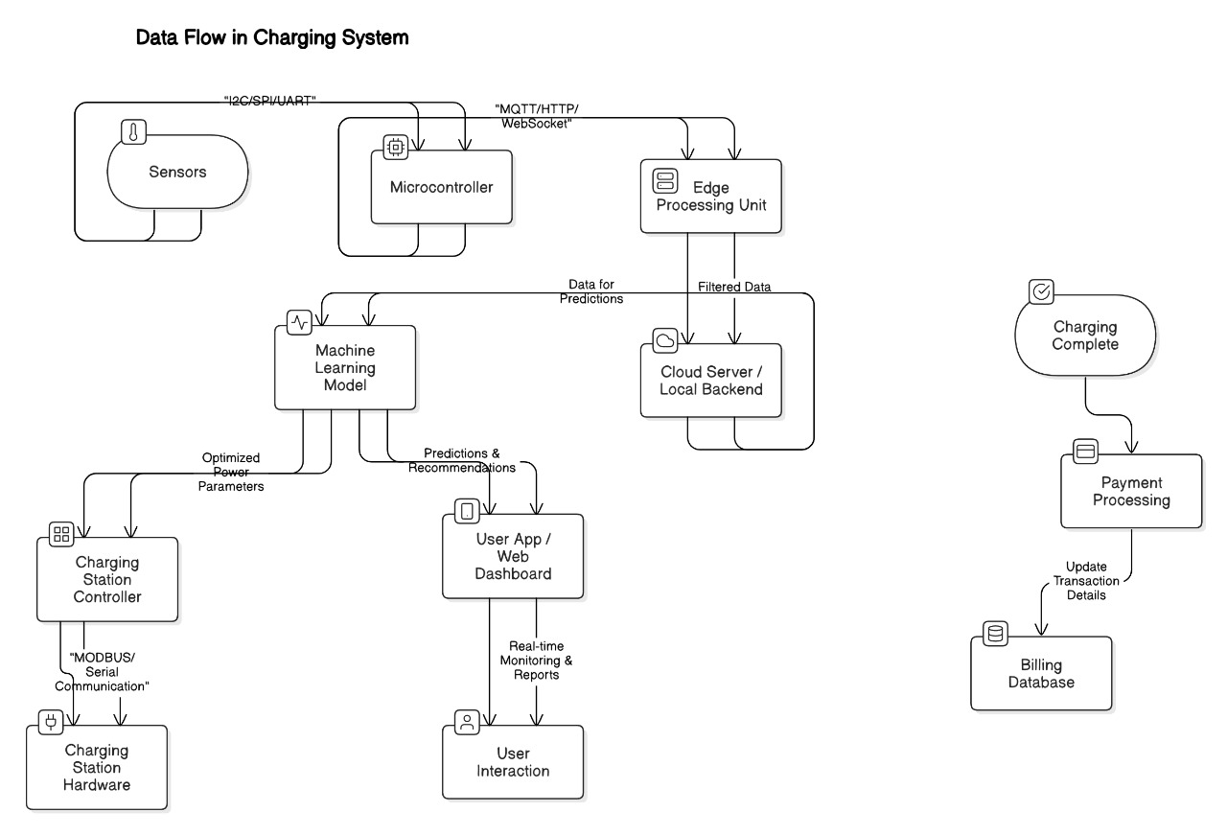
Work Done
1. System Design & Architecture
Designed a high-level architecture for data collection, processing, and decision-making.
Defined system components: sensors, cloud storage, ML model, and alert mechanism.
Developed block diagram and data flow models for implementation.
Developed Software Requirements Specification (SRS)

Slide 18
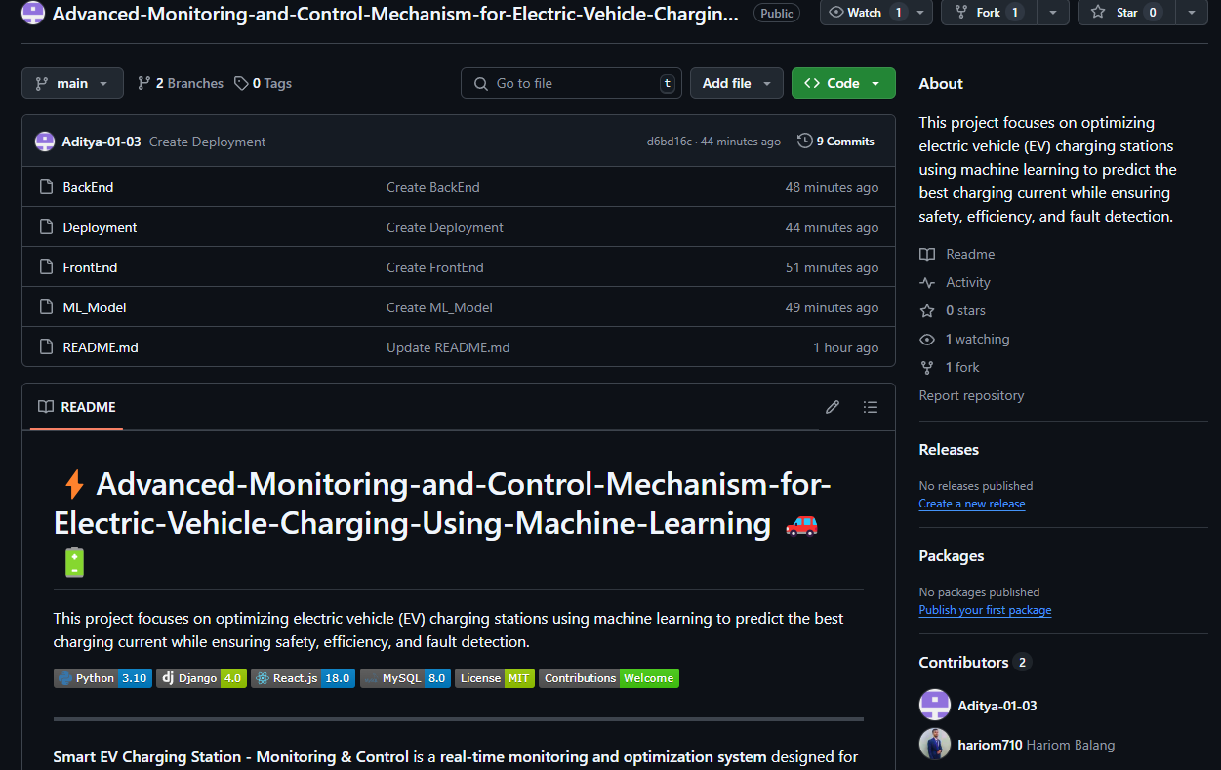
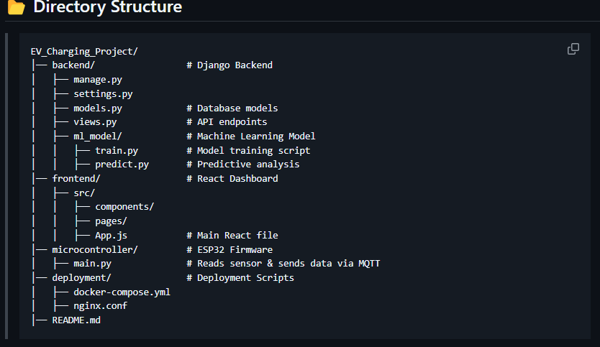
Work Done
2.Create github repository
For collaborative work and better efficiency we use github for project
https://github.com/hariom710/Advanced-Monitoring-and-Control-Mechanism-for-Electric-Vehicle-Charging-Using-Machine-Learning.git

Slide 19
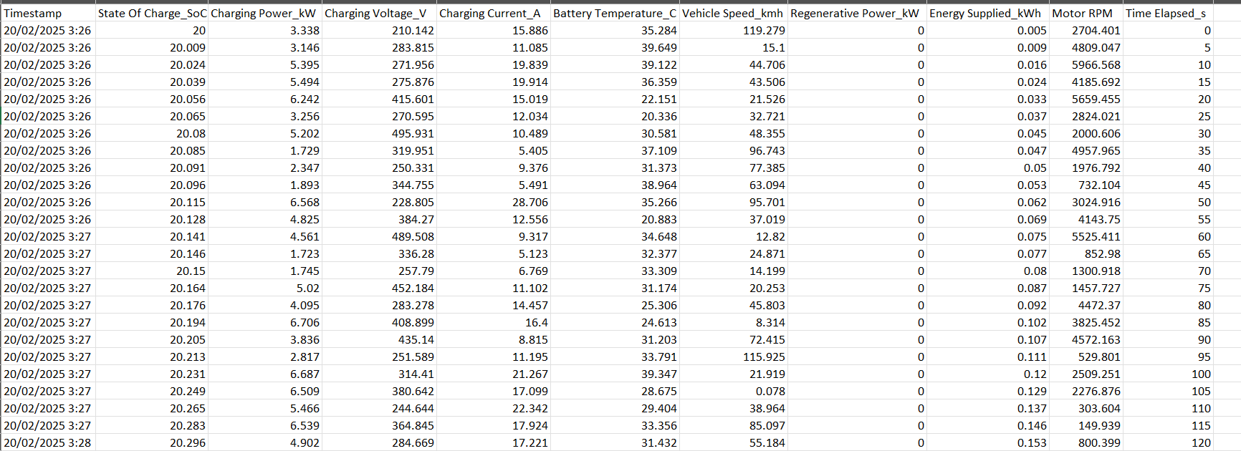
Work Done
3. Data Acquisition & Pre-processing
Collected real-world EV charging data.
Identified key parameters: voltage, current, temperature, battery temperature etc.
Cleaned and normalized data to ensure consistency and remove anomalies.

Slide 20
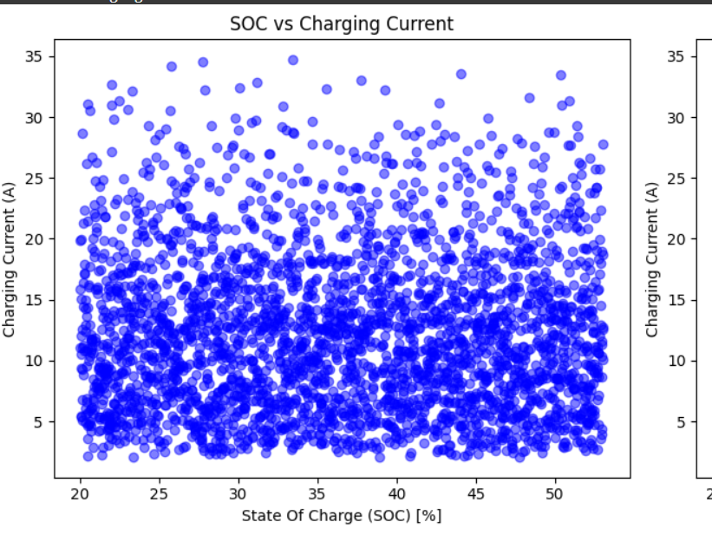
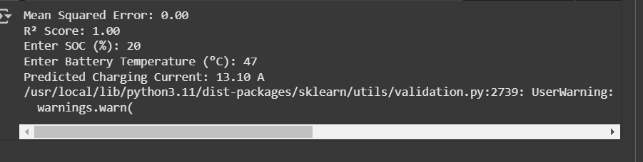
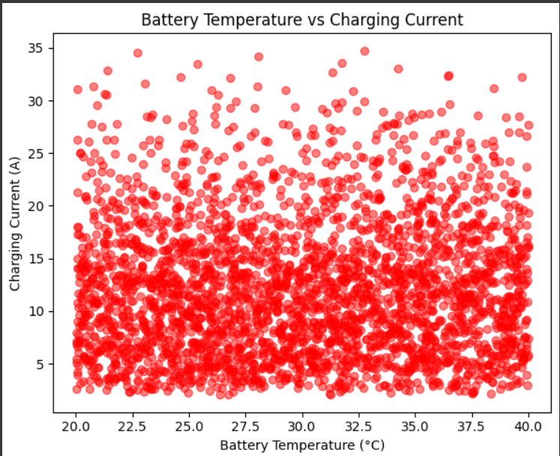
Work Done
We visualize given data using scatterplot to draw conclusion
Run the preprocessed data on basic ML model.

Slide 21


Work Done
4. Initial Model Building Steps
Explored platforms like Google Colab and Jupyter Notebook for model training.
Experimented with Random Forest, XGBoost, and other ML algorithms for pattern detection.
Conducted initial feature selection and performance evaluation.
5. Challenges & Next Steps
Challenges: Real-time deployment.
Next Steps: Model training, evaluation, integration with hardware, and real-time testing.

Slide 22
Conclusion
Innovative Solution for EV Charging
Our project provides an advanced monitoring and control mechanism to enhance the efficiency and reliability of EV charging stations.
Enhancing Safety & Performance
With real-time fault detection and correction, the system ensures safe and uninterrupted charging while reducing downtime.
Energy-Efficient & Cost-Effective
The intelligent system optimizes power consumption, minimizes energy wastage, and reduces operational costs for both users and station operators.
Future-Ready & Scalable
This solution supports smart city infrastructure and can be scaled for widespread EV adoption, contributing to a sustainable and greener future.

Slide 23
Patentibility/Copyright
•Patent: Yes/NO (*To be decided by Committee and Guide)
•Research Paper: Conference/Journal (*To be decided by Committee and Guide)
(*Note: POST - PROJECT SUBMISSION REQUIREMENT: : As mentioned earlier, the project titles and the scope of projects shall be such that at least ONE SCOPUS / WoS indexed publication / Book Chapter / Patent is derived out of the project work. The student has to pay the fees for publication. It shall clarify to all Project Guides and the project students that if the desired aim is not achieved before ESE Viva Voce of VII Sem ESE, the project may be extended to next SIX months and the final viva voce of project shall be conducted at the time of VIII Sem ESE.)

Slide 24
Social Utility
1. Promoting EV Adoption & Green Mobility
Efficient & reliable charging encourages more users to switch to EVs.
Reduces range anxiety by preventing failures and optimizing charging performance.
2. Energy Efficiency & Sustainability
Minimizes energy wastage by dynamically adjusting the charging current.
Supports renewable energy integration for a more eco-friendly charging process.
3. Enhancing Safety & Reliability
Real-time fault detection prevents hazards and improves system safety.
Automated correction mechanisms ensure uninterrupted charging services.
4. Cost Savings for Users & Operators
Optimized power usage reduces electricity bills and unnecessary energy consumption.
Predictive maintenance lowers repair costs and extends equipment lifespan.
5. Supporting Smart Cities & Urban Planning
Helps build intelligent & sustainable urban infrastructure with data-driven insights.
Contributes to carbon footprint reduction by ensuring optimal EV charging.

Slide 25
References(*Strictly in IEEE format)
1.Almaghrebi, A.; Aljuheshi, F.; Rafaie, M.; James, K.; Alahmad, M. Data-Driven Charging Demand Prediction at Public Charging Stations Using Supervised Machine Learning Regression Methods. Energies 2020, 13, 4231. https://doi.org/10.3390/en13164231
2.Shufian, Abu & Hannan, Nasif & Emon, Mukter Hossain & Kabir, Shaharier & Fattah, Shaikh Anowarul & Hossain, Md Sajid. (2024). Automatic Fault Detection and Analysis Of Electric Vehicle Charging Station by Machine Learning. 10.1109/TENSYMP61132.2024.10752256.
3.S. Shahriar, A. R. Al-Ali, A. H. Osman, S. Dhou and M. Nijim, "Prediction of EV Charging Behavior Using Machine Learning," in IEEE Access, vol. 9, pp. 111576-111586
4.K. N. B. S. Hitesh, P. S. Teja and J. R. Kumar, "Electric Vehicle Charging Demand Prediction using Machine Learning Algorithms," 2024 8th International Conference on Inventive Systems and Control (ICISC), Coimbatore, India, 2024, pp. 47-54, doi: 10.1109/ICISC62624.2024.00015.
5.Aghsaee, R.; Hecht, C.; Schwinger, F.; Figgener, J.; Jarke, M.; Sauer, D.U. Data-Driven, Short-Term Prediction of Charging Station Occupation. Electricity 2023, 4, 134-153. https://doi.org/10.3390/electricity4020009
6.S. M. S and R. Gunabalan, "Enhancement of Charging Efficiency of Batteries for Electric Vehicles: Review," 2022 Fourth International Conference on Emerging Research in Electronics, Computer Science and Technology (ICERECT), Mandya, India, 2022, pp. 1-6, doi: 10.1109/ICERECT56837.2022.10060243.
7.S. Deb, "Machine Learning for Solving Charging Infrastructure Planning: A Comprehensive Review," 2021 5th International Conference on Smart Grid and Smart Cities (ICSGSC), Tokyo, Japan, 2021, pp. 16-22, doi: 10.1109/ICSGSC52434.2021.9490407.

Slide 26
References(*Strictly in IEEE format)
8.M. Straka, R. Carvalho, G. V. D. Poel and L. Buzna, "Analysis of Energy Consumption at Slow Charging Infrastructure for Electric Vehicles," in IEEE Access, vol. 9, pp. 53885-53901, 2021, doi: 10.1109/ACCESS.2021.3071180.
9.A. Shufian, N. Hannan, M. M. Hossain Emon, S. Kabir, S. A. Fattah and M. S. Hossain, "Automatic Fault Detection and Analysis Of Electric Vehicle Charging Station by Machine Learning," 2024 IEEE Region 10 Symposium (TENSYMP), New Delhi, India, 2024, pp. 1-6, doi: 10.1109/TENSYMP61132.2024.10752256.
10.R. Atallah et al., "Quality of Service Evaluation and Forecast for EV Charging Based on Real-World Data," 2023 19th International Conference on Wireless and Mobile Computing, Networking and Communications (WiMob), Montreal, QC, Canada, 2023, pp. 280-285, doi: 10.1109/WiMob58348.2023.10187855.
11.S. Shahriar, A. R. Al-Ali, A. H. Osman, S. Dhou and M. Nijim, "Machine Learning Approaches for EV Charging Behavior: A Review," in IEEE Access, vol. 8, pp. 168980-168993, 2020, doi: 10.1109/ACCESS.2020.3023388.
12.M. Shukla, D. K. Singh, A. Yadav, A. K. Singh, N. A. Jumaa and A. Mohammed, "Optimizing Electric Vehicle Charging Station Placement in Urban Areas: A Data-Driven Approach," 2023 3rd International Conference on Advance Computing and Innovative Technologies in Engineering (ICACITE), Greater Noida, India, 2023, pp. 2835-2838, doi: 10.1109/ICACITE57410.2023.10183075.
13.A. Palaniappan, P. Bhukya, S. K. Chitti and J. Gao, "Data-Driven Analysis of EV Energy Prediction and Planning of EV Charging Infrastructure," 2023 IEEE Ninth International Conference on Big Data Computing Service and Applications (BigDataService), Athens, Greece, 2023, pp. 17-24, doi: 10.1109/BigDataService58306.2023.00009
14.A. Almaghrebi, F. A. Juheshi, J. Nekl, K. James and M. Alahmad, "Analysis of Energy Consumption at Public Charging Stations, a Nebraska Case Study," 2020 IEEE Transportation Electrification Conference & Expo (ITEC), Chicago, IL, USA, 2020, pp. 1-6, doi: 10.1109/ITEC48692.2020.9161456.

Slide 27



